Slide 1
Linear Model

Slide 2

Machine Learning
What would be the grade if I study 4 hours?
4 hours
? points
Prediction
Hours (x) | Points (y)
1 | 2
2 | 4
3 | 6
4 | ?
Training dataset
Test dataset

Slide 3
Math and computer approaches
Hours (x) | Points (y)
1 | 2
2 | 4
3 | 6
4 | ?
y = w * x → How do you know it is multiplication?
2 = w * 1 → Use labeled value to predict
w = 2 → This is math way

Slide 4
How about this?
Hours (x) | Points (y)
1 | 13.5724
7 | 10.23315
16 | 22.5731
224 | -15.7414
How do you know it is linear or not?
How can you know there exists a solution to this?
How can you know that some data are noise?

Slide 5

Machine Learning
What would be the grade if I study 4 hours?
4 hours
? points
Prediction
Hours (x) | Points (y)
1 | 2
2 | 4
3 | 6
4 | ?
Training dataset
Supervised learning
Test dataset

Slide 6
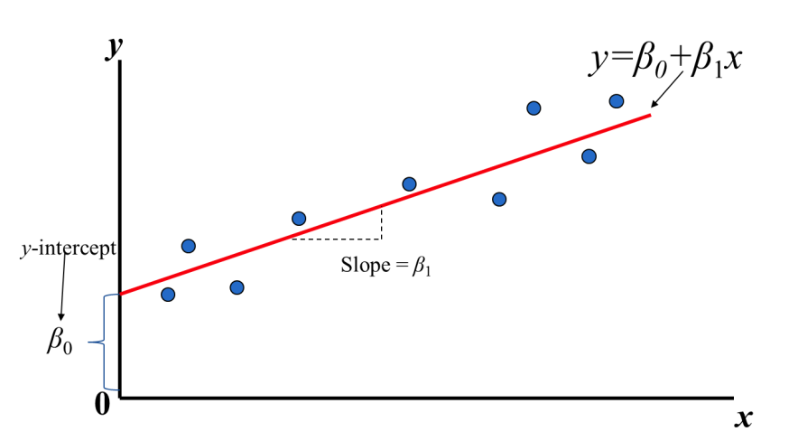
Draw a line
Find the line that best fits the distributoion
Hours (x) | Points (y)
1 | 2
2 | 4
3 | 6
4 | ?
Notes:
\hat{y}=x*w+b

Slide 7
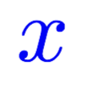
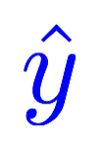
Model design
What would be the best model for the data? Linear?
Hours (x) | Points (y)
1 | 2
2 | 4
3 | 6
4 | ?
Linear
Notes:
\hat{y}=x*w+b

Slide 8


Model design
What would be the best model for the data? Linear?
Hours (x) | Points (y)
1 | 2
2 | 4
3 | 6
4 | ?
Linear
Notes:
\hat{y}=x*w+b

Slide 9
Linear Regression
Find the line that best fits the distributoion
Hours (x) | Points (y)
1 | 2
2 | 4
3 | 6
4 | ?
Notes:
\hat{y}=x*w+b

Slide 10
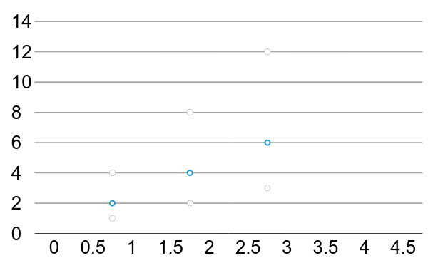
Linear Regression
For simplication, get rid of b
Hours (x) | Points (y)
1 | 2
2 | 4
3 | 6
True line

Slide 11
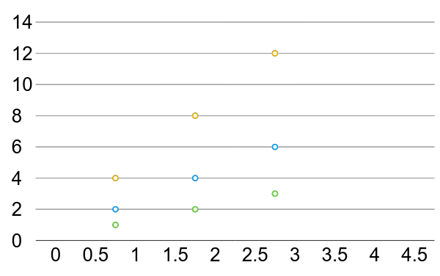
Linear Regression error?
* The machine starts with a random guess, w=random value
Hours (x) | Points (y)
1 | 2
2 | 4
3 | 6

Slide 12
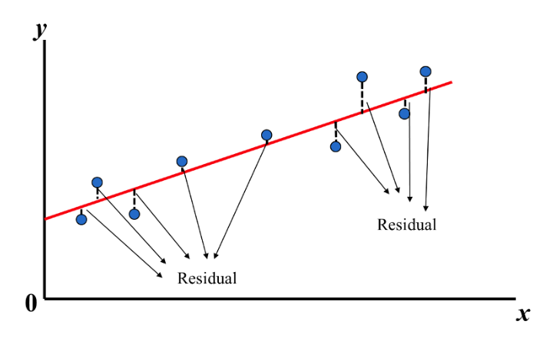
Linear Regression error?
Find the red line that all the ‘y’ distances are minimal
* The machine starts with a random guess, w=random value
Hours (x) | Points (y)
1 | 2
2 | 4
3 | 6

Slide 13
How to measure? We need a way to find if the line fits all the points The best way is to find the distances between points and the line

Slide 14
How to measure?

Slide 15
Training Loss (error) Make it positive and easy to get derivation
Hours, x | Points, y | Prediction, y^(w=3) | Loss (w=3)
1 | 2 | 3 | 1
2 | 4 | 6 | 4
3 | 6 | 9 | 9
 |  |  | mean=14/3
Notes:
loss = (\hat{y}-y)^2 = (x*w-y)^2

Slide 16
Training Loss (error)
Hours, x | Points, y | Prediction, y^(w=4) | Loss (w=4)
1 | 2 | 4 | 4
2 | 4 | 8 | 16
3 | 6 | 12 | 36
 |  |  | mean=56/3
Notes:
loss = (\hat{y}-y)^2 = (x*w-y)^2

Slide 17
Training Loss (error)
Hours, x | Points, y | Prediction, y^(w=0) | Loss (w=0)
1 | 2 | 0 | 4
2 | 4 | 0 | 16
3 | 6 | 0 | 36
 |  |  | mean=56/3
Notes:
loss = (\hat{y}-y)^2 = (x*w-y)^2

Slide 18
Training Loss (error)
Hours, x | Points, y | Prediction, y^(w=1) | Loss (w=1)
1 | 2 | 1 | 1
2 | 4 | 2 | 4
3 | 6 | 3 | 9
 |  |  | mean=14/3
Notes:
loss = (\hat{y}-y)^2 = (x*w-y)^2

Slide 19
Training Loss (error)
Hours, x | Points, y | Prediction, y^(w=2) | Loss (w=2)
1 | 2 | 2 | 0
2 | 4 | 4 | 0
3 | 6 | 6 | 0
 |  |  | mean=0
Notes:
loss = (\hat{y}-y)^2 = (x*w-y)^2

Slide 20
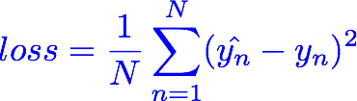
Training Loss (error)
MSE, mean square error
Hours, x | Loss (w=0) | Loss (w=1) | Loss (w=2) | Loss (w=3) | Loss (w=4)
1 | 4 | 1 | 0 | 1 | 4
2 | 16 | 4 | 0 | 4 | 16
3 | 36 | 9 | 0 | 9 | 36
 | MSE=56/3=18.7 | MSE=14/3=4.7 | MSE=0 | MSE=14/3=4.7 | MSE=56/3=18.7
Notes:
loss = (\hat{y}-y)^2 = (x*w-y)^2

Slide 21
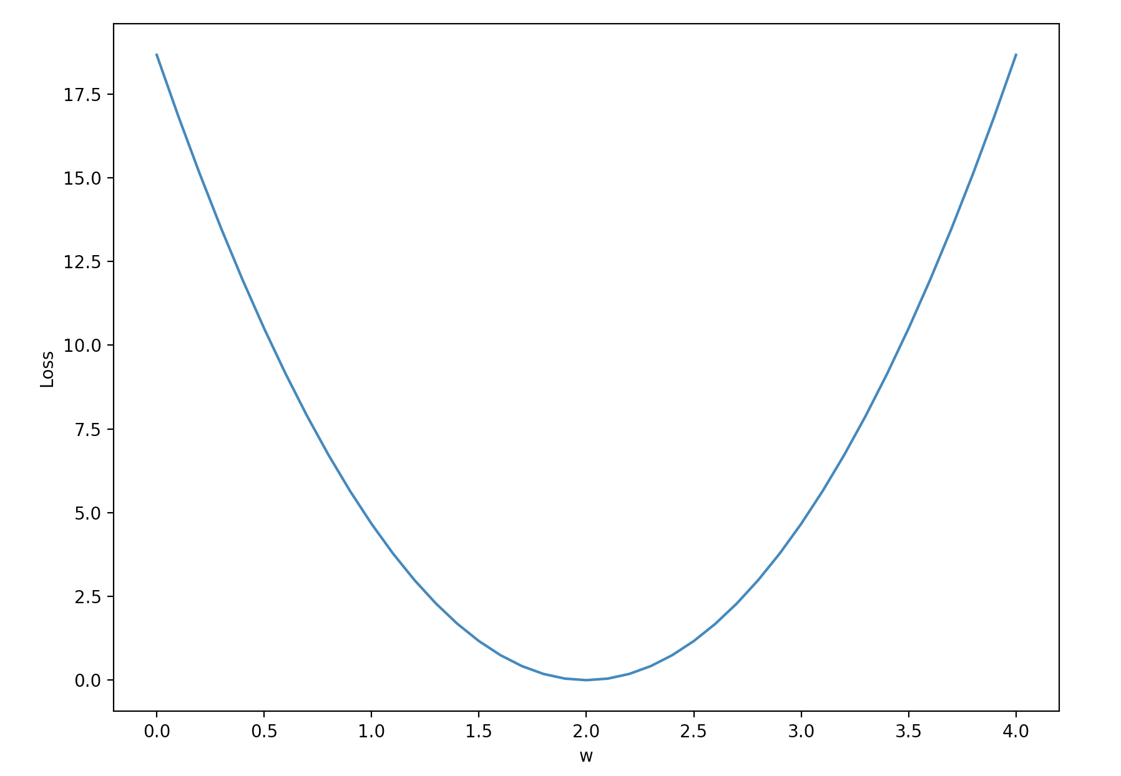
Loss graph
Loss (w=0) | Loss (w=1) | Loss (w=2) | Loss (w=3) | Loss (w=4)
mean=56/3=18.7 | mean=14/3=4.7 | mean=0 | mean=14/3=4.7 | mean=56/3=18.7
Loss
w
Notes:
loss = (\hat{y}-y)^2 = (x*w-y)^2

Slide 22
Loss graph
Loss (w=0) | Loss (w=1) | Loss (w=2) | Loss (w=3) | Loss (w=4)
mean=56/3=18.7 | mean=14/3=4.7 | mean=0 | mean=14/3=4.7 | mean=56/3=18.7
Loss
w
Notes:
loss = (\hat{y}-y)^2 = (x*w-y)^2

Slide 23

Model & Loss
w = 1.0 # a random guess: random value
# our model for the forward pass
def forward(x):
return x * w
# Loss function
def loss(x, y):
y_pred = forward(x)
return (y_pred - y) * (y_pred - y)

Slide 24


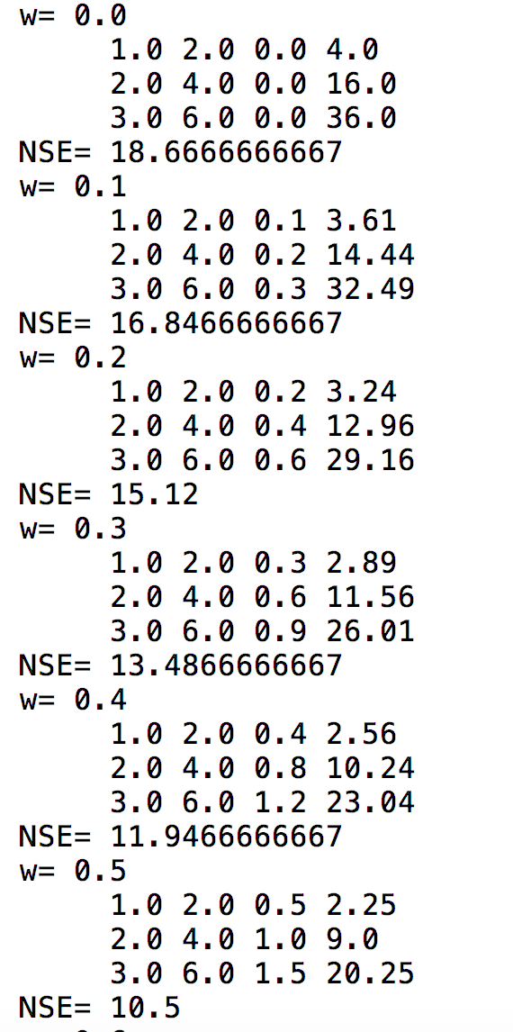
Compute loss for w
for w in np.arange(0.0, 4.1, 0.1):
print("w=", w)
l_sum = 0
for x_val, y_val in zip(x_data, y_data):
y_pred_val = forward(x_val)
l = loss(x_val, y_val)
l_sum += l
print("\t", x_val, y_val, y_pred_val, l)
print("MSE=", l_sum / 3)

Slide 25
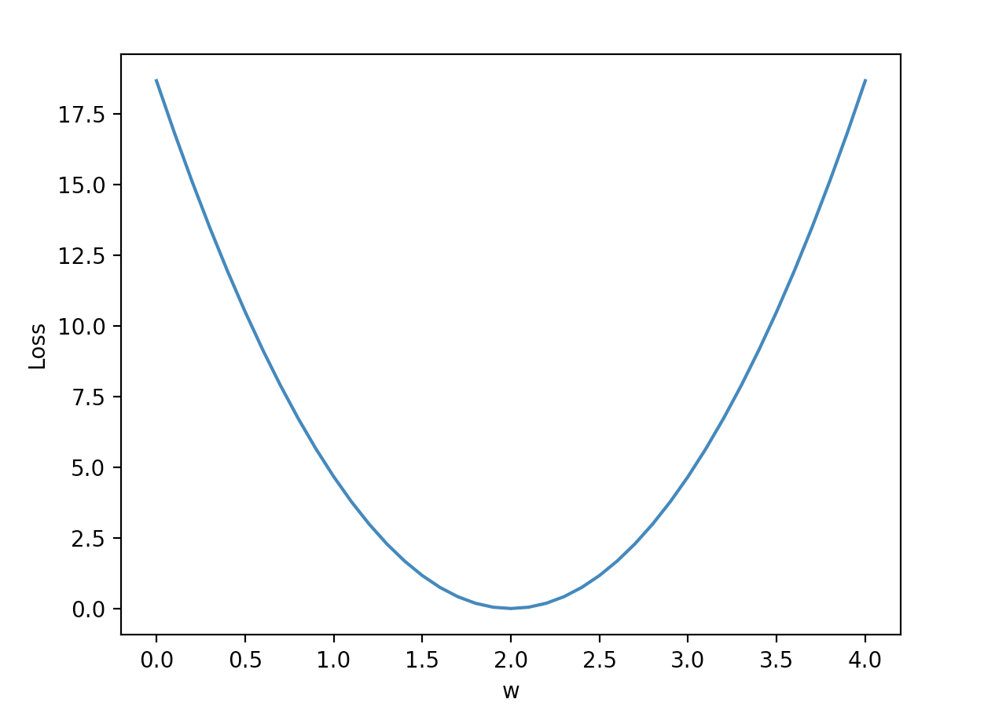
Plot graph
w_list = []
mse_list = []
for w in np.arange(0.0, 4.1, 0.1):
print("w=", w)
l_sum = 0
for x_val, y_val in zip(x_data, y_data):
y_pred_val = forward(x_val)
l = loss(x_val, y_val)
l_sum += l
print("\t", x_val, y_val, y_pred_val, l)
print("MSE=", l_sum / 3)
w_list.append(w)
mse_list.append(l_sum / 3)
plt.plot(w_list, mse_list)
plt.ylabel('Loss')
plt.xlabel('w')
plt.show()

Slide 26
import numpy as np
import matplotlib.pyplot as plt
x_data = [1.0, 2.0, 3.0]
y_data = [2.0, 4.0, 6.0]
w = 1.0 # a random guess: random value, 1.0
# our model for the forward pass
def forward(x):
return x * w
# Loss function
def loss(x, y):
y_pred = forward(x)
return (y_pred - y) * (y_pred - y)
w_list = []
mse_list = []
for w in np.arange(0.0, 4.1, 0.1):
print("w=", w)
l_sum = 0
for x_val, y_val in zip(x_data, y_data):
y_pred_val = forward(x_val)
l = loss(x_val, y_val)
l_sum += l
print("\t", x_val, y_val, y_pred_val, l)
print("MSE=", l_sum / 3)
w_list.append(w)
mse_list.append(l_sum / 3)
plt.plot(w_list, mse_list)
plt.ylabel('Loss')
plt.xlabel('w')
plt.show()
Linear

Slide 27
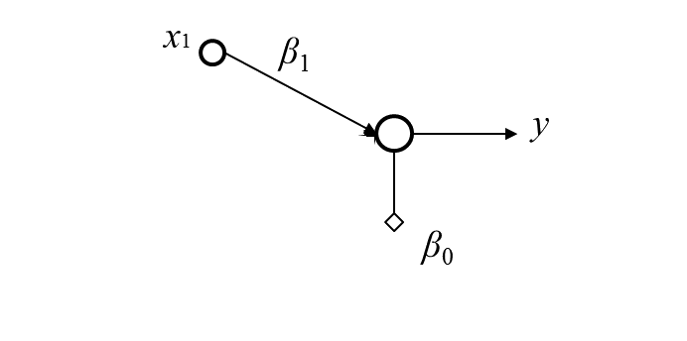
Linear Regression
One dimension linear regression

Slide 28

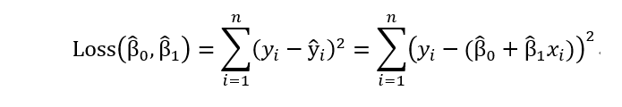

Calculate Bias and Weight
Notes:
loss = (\hat{y}-y)^2 = (x*w-y)^2

Slide 29
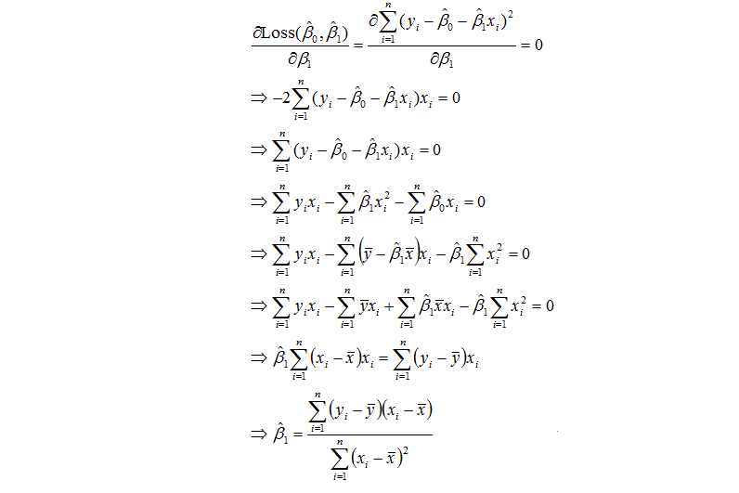
Calculate Bias and Weight
Notes:
loss = (\hat{y}-y)^2 = (x*w-y)^2

Slide 30
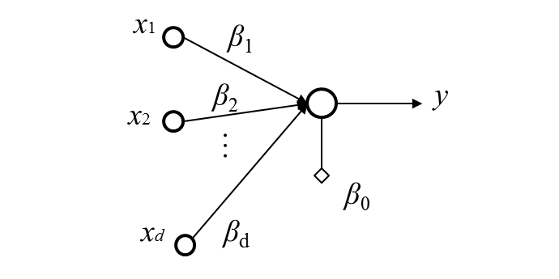
Linear Regression
Multi-dimension linear regression

Slide 31
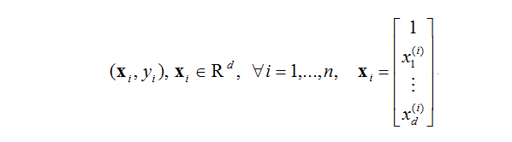
Calculate Bias and Weight
Notes:
loss = (\hat{y}-y)^2 = (x*w-y)^2

Slide 32
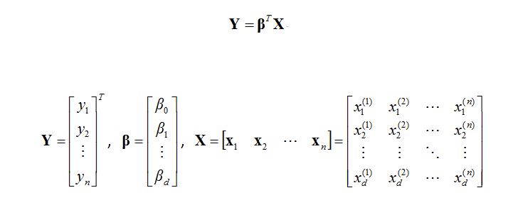
Calculate Bias and Weight
Notes:
loss = (\hat{y}-y)^2 = (x*w-y)^2

Slide 33
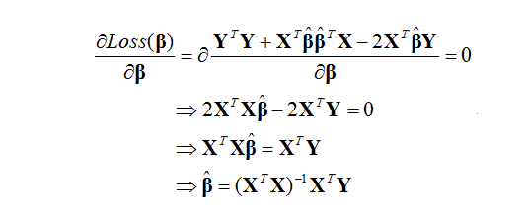
Calculate Bias and Weight
Notes:
loss = (\hat{y}-y)^2 = (x*w-y)^2

Slide 34

Calculate Bias and Weight
Notes:
loss = (\hat{y}-y)^2 = (x*w-y)^2

Slide 35
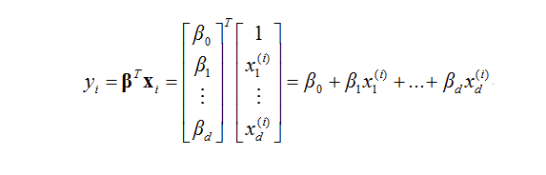
Calculate Bias and Weight
Notes:
loss = (\hat{y}-y)^2 = (x*w-y)^2

Slide 36
Gradient Descent

Slide 37
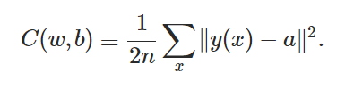
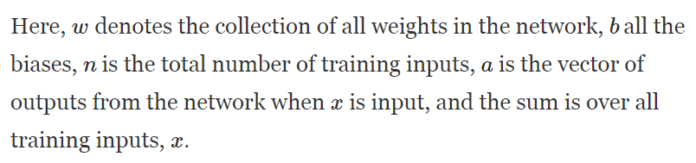
Loss(Cost) Function
Notes:
loss = (\hat{y}-y)^2 = (x*w-y)^2

Slide 38
Loss(Cost) Function
||v|| denotes a distance of a vector → A scalar
Square value → means it is always positive.
a = wx + b → A function of weights and biases.
The reason that the cost function doesn’t’ use an ‘absolute’ function is for smoothness. → Easy to calculate derivatives.
Notes:
loss = (\hat{y}-y)^2 = (x*w-y)^2

Slide 39


Loss(Cost) Function
Notes:
loss = (\hat{y}-y)^2 = (x*w-y)^2

Slide 40
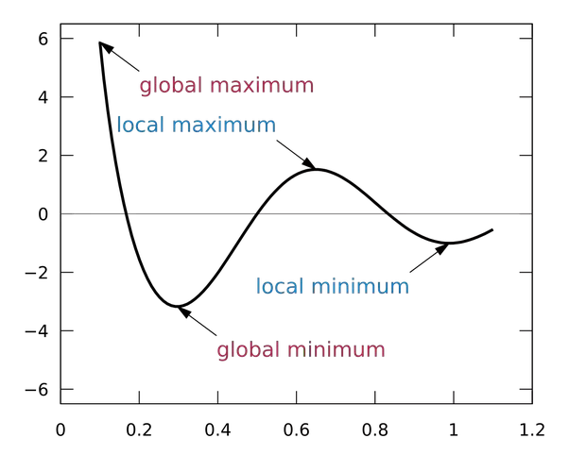
Find global minimum
Notes:
loss = (\hat{y}-y)^2 = (x*w-y)^2

Slide 41
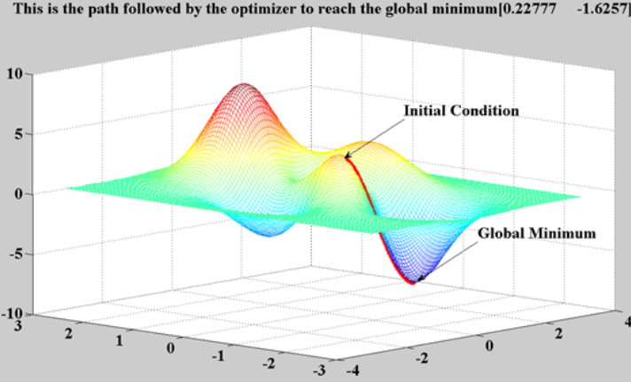
Find global minimum
Notes:
loss = (\hat{y}-y)^2 = (x*w-y)^2

Slide 42
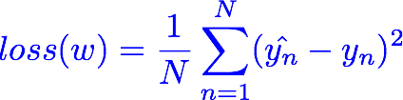
Loss(Cost) Function two dimension
Notes:
loss = (\hat{y}-y)^2 = (x*w-y)^2

Slide 43
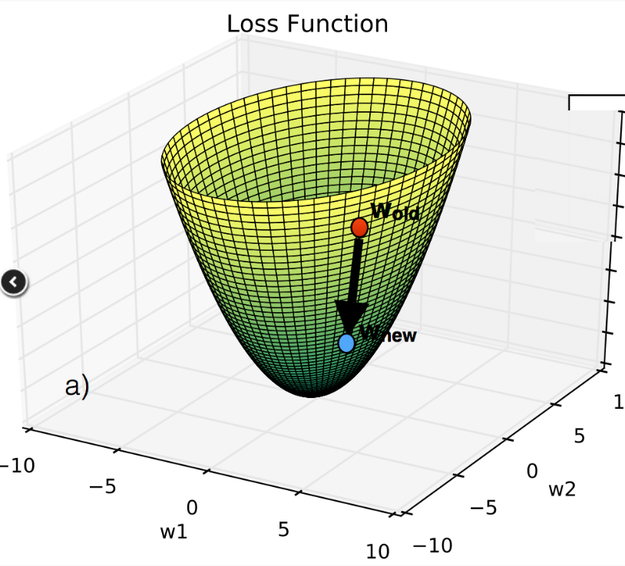
Loss(Cost) Function three dimension
Notes:
loss = (\hat{y}-y)^2 = (x*w-y)^2

Slide 44

Loss(Cost) Function n dimension
Notes:
loss = (\hat{y}-y)^2 = (x*w-y)^2

Slide 45
Problem Attacker
When there are no obvious MATH way to solve this problem, we switch to COMPUTER way.
Step by Step
Notes:
loss = (\hat{y}-y)^2 = (x*w-y)^2

Slide 46
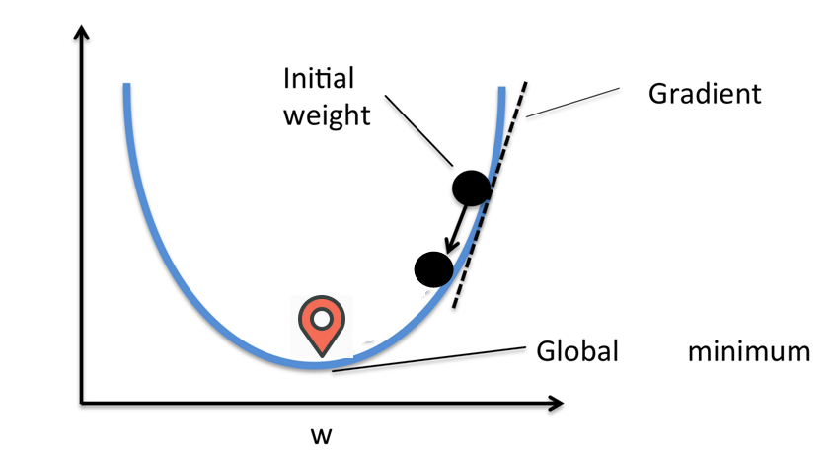
Move down a little step by step
For two dimension space, there is only ONE direction toward the bottom of global minimum, it is the tangent line direction.
Notes:
loss = (\hat{y}-y)^2 = (x*w-y)^2
\frac{\partial{loss}}{\partial{w}}=?

Slide 47
Find a point first Then find next point
Find a random point first, and try to find the next point that goes down the fastest. Repeat this procedure until we reach the global minimum.
Notes:
loss = (\hat{y}-y)^2 = (x*w-y)^2

Slide 48
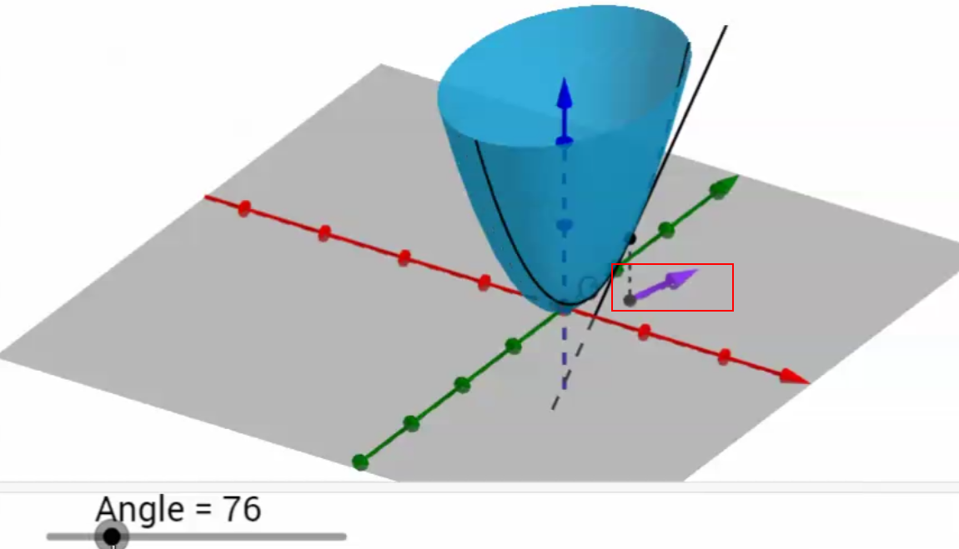
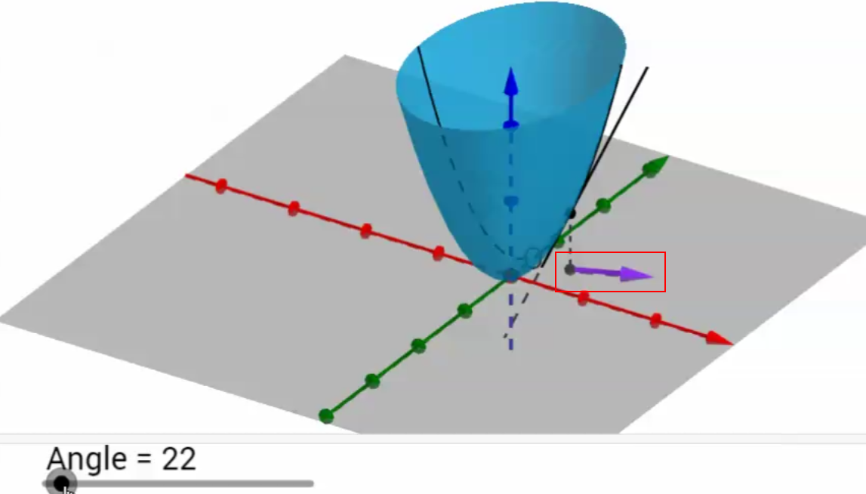
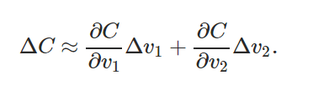
Move down a little step by step
For n dimension space, there are INFINITE directions toward the bottom of global minimum.
WHICH DIRECTION TO GO DOWN TO BOTTOM THE FASTEST?
Notes:
loss = (\hat{y}-y)^2 = (x*w-y)^2
\frac{\partial{loss}}{\partial{w}}=?

Slide 49


Slide 50
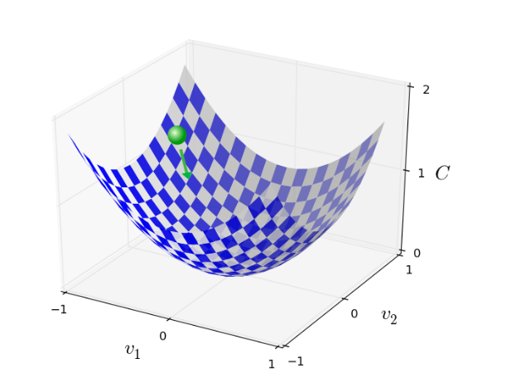
The Gradient Descent

Slide 51
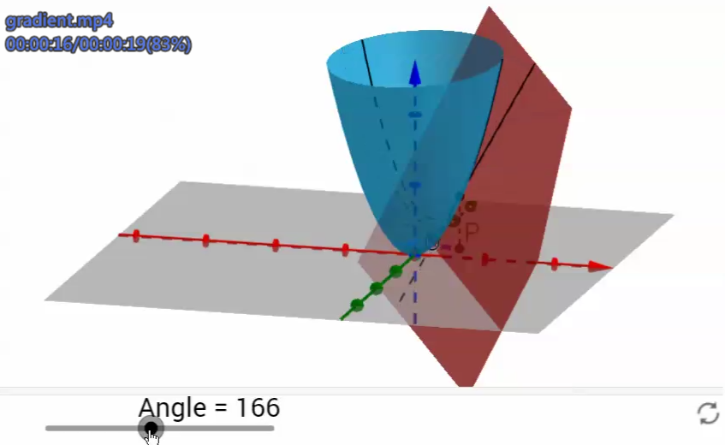
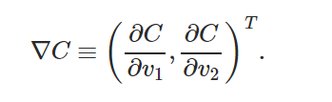
The Tangent Plane
On a single point, there is ONLY ONE plane tangent to the point. However there are INFINITE lines tangent to that point on that only plane..
The tangent line that has the maximum slope is called GRADIENT.

Slide 52
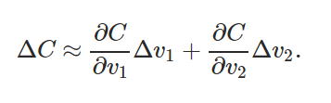
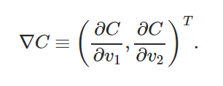



The Gradient Descent

Slide 53
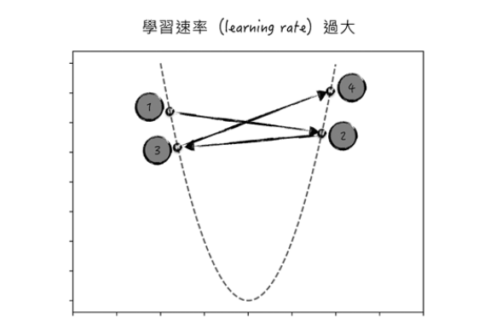
Carefully choosing

Slide 54
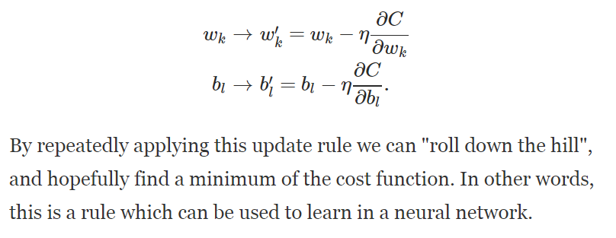
The Gradient Descent

Slide 55
The Gradient Descent

Slide 56

The Problem of Gradient Descent
We need to compute the gradients ∇Cx separately for each training input, x, and then average them
When the number of training inputs is very large this can take a long time

Slide 57
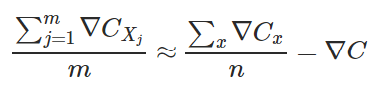
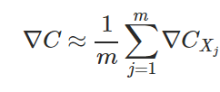
Stochastic Gradient Descent(SGD)
Choose a small m number of training inputs → MINI BATCH
Calculate the gradient of the mini batch, which equals to the real gradient of all samples.
When we have completed all the batches once, it’s called an EPOCH
After that we start a new epoch.

Slide 58
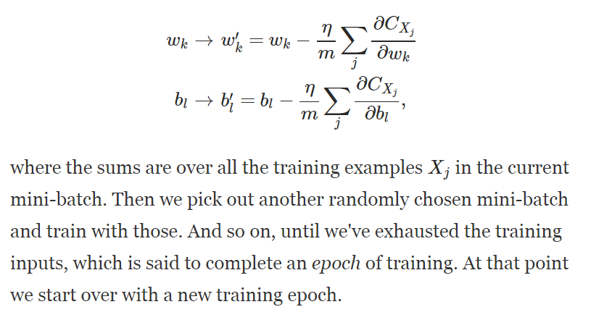
Stochastic Gradient Descent(SGD)

Slide 59

Stochastic Gradient Descent(SGD)
It is like political POLLING, easier to get small number of sample vs. all samples
For MNIST, choose a mini-batch of size 10, for 60000 samples.
The gradient of the mini batch is NOT perfect, but good enough to do SGD.
Only need 6000 times to get the true gradient.

Slide 60
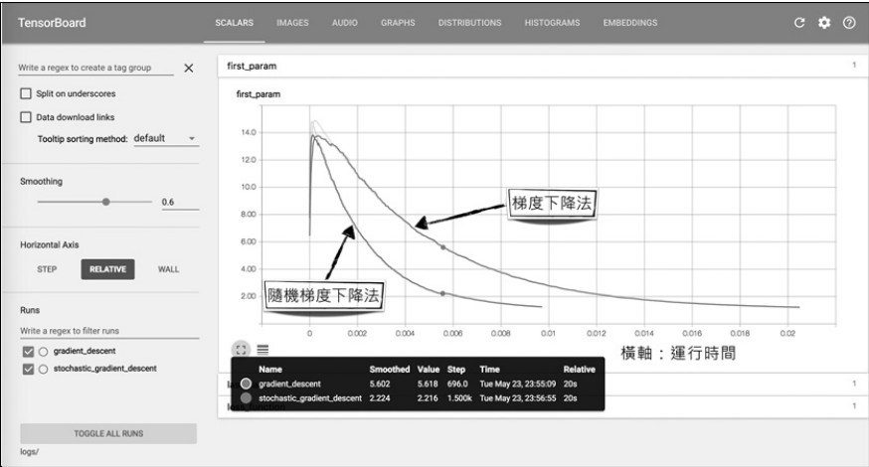
SGD: Faster Converging

Slide 61
Loss graph
Loss (w=0) | Loss (w=1) | Loss (w=2) | Loss (w=3) | Loss (w=4)
mean=56/3=18.7 | mean=14/3=4.7 | mean=0 | mean=14/3=4.7 | mean=56/3=18.7
Notes:
loss = (\hat{y}-y)^2 = (x*w-y)^2

Slide 62
Linear Regression error?

Slide 63

What is the learning: find w that minimizes the loss
Loss (w=0) | Loss (w=1) | Loss (w=2) | Loss (w=3) | Loss (w=4)
mean=56/3=18.7 | mean=14/3=4.7 | mean=0 | mean=14/3=4.7 | mean=56/3=18.7
Notes:
loss = (\hat{y}-y)^2 = (x*w-y)^2

Slide 64
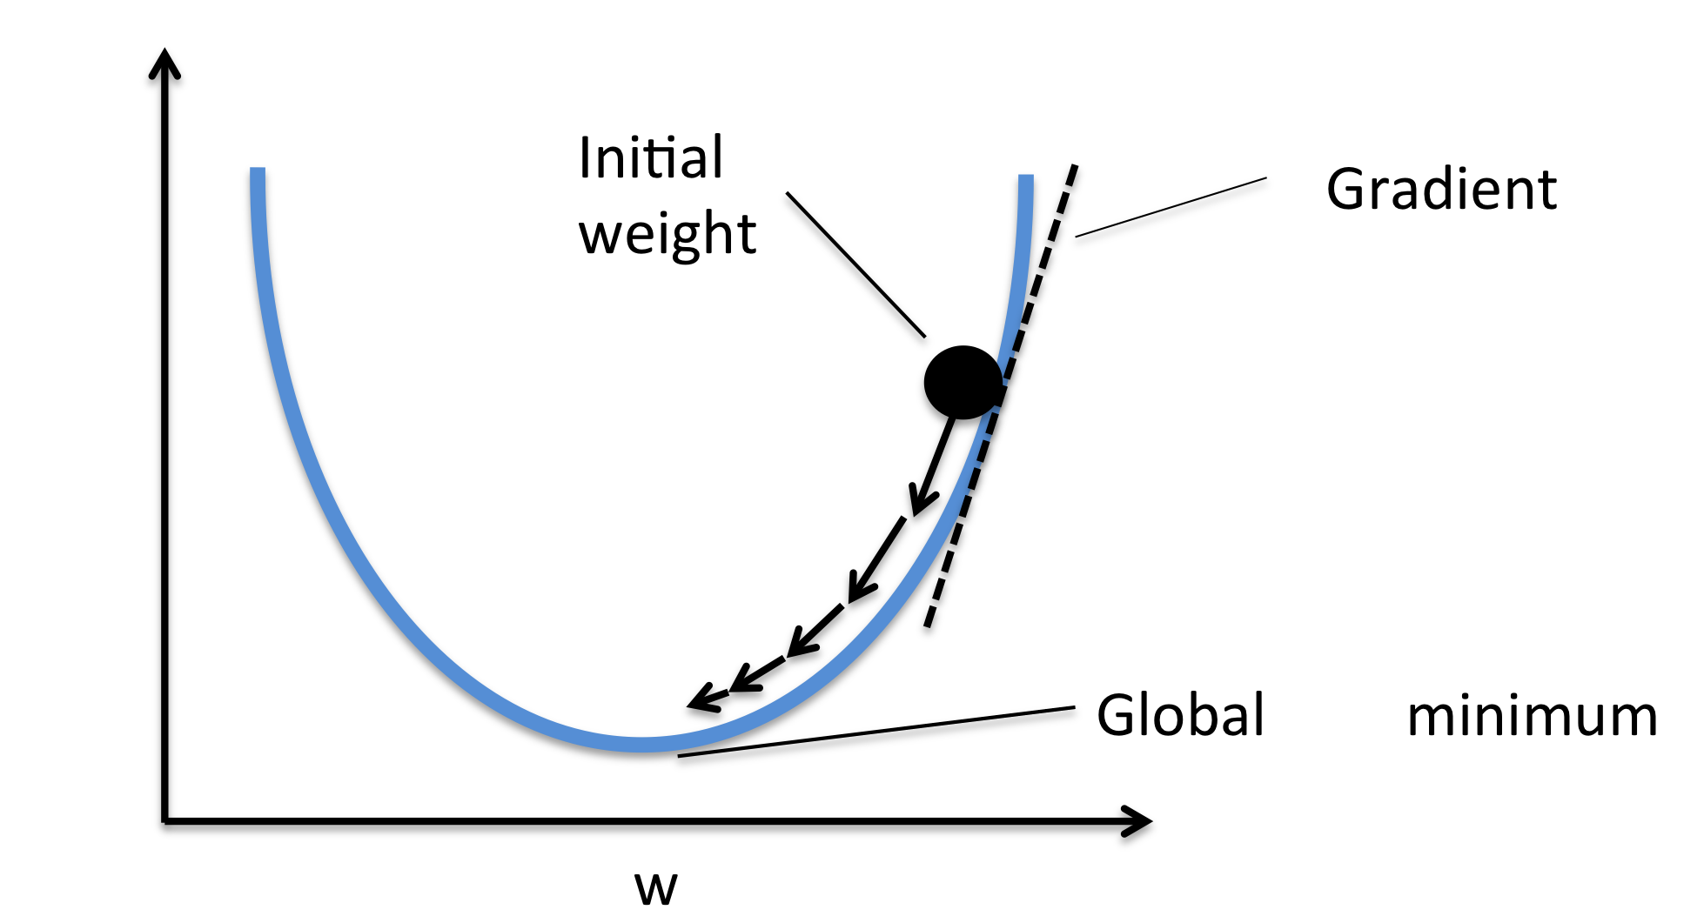

Gradient descent algorithm
loss
loss
Notes:
loss = (\hat{y}-y)^2 = (x*w-y)^2
\frac{\partial{loss}}{\partial{w}}=?

Slide 65


Gradient descent algorithm
loss
loss
Notes:
loss = (\hat{y}-y)^2 = (x*w-y)^2
\frac{\partial{loss}}{\partial{w}}=?

Slide 66
Derivative
Notes:
loss = (\hat{y}-y)^2 = (x*w-y)^2
\frac{\partial{loss}}{\partial{w}}=?

Slide 67

Derivative
Notes:
loss = (\hat{y}-y)^2 = (x*w-y)^2
\frac{\partial{loss}}{\partial{w}}=?

Slide 68
Derivative
Notes:
loss = (\hat{y}-y)^2 = (x*w-y)^2
\frac{\partial{loss}}{\partial{w}}=?

Slide 69
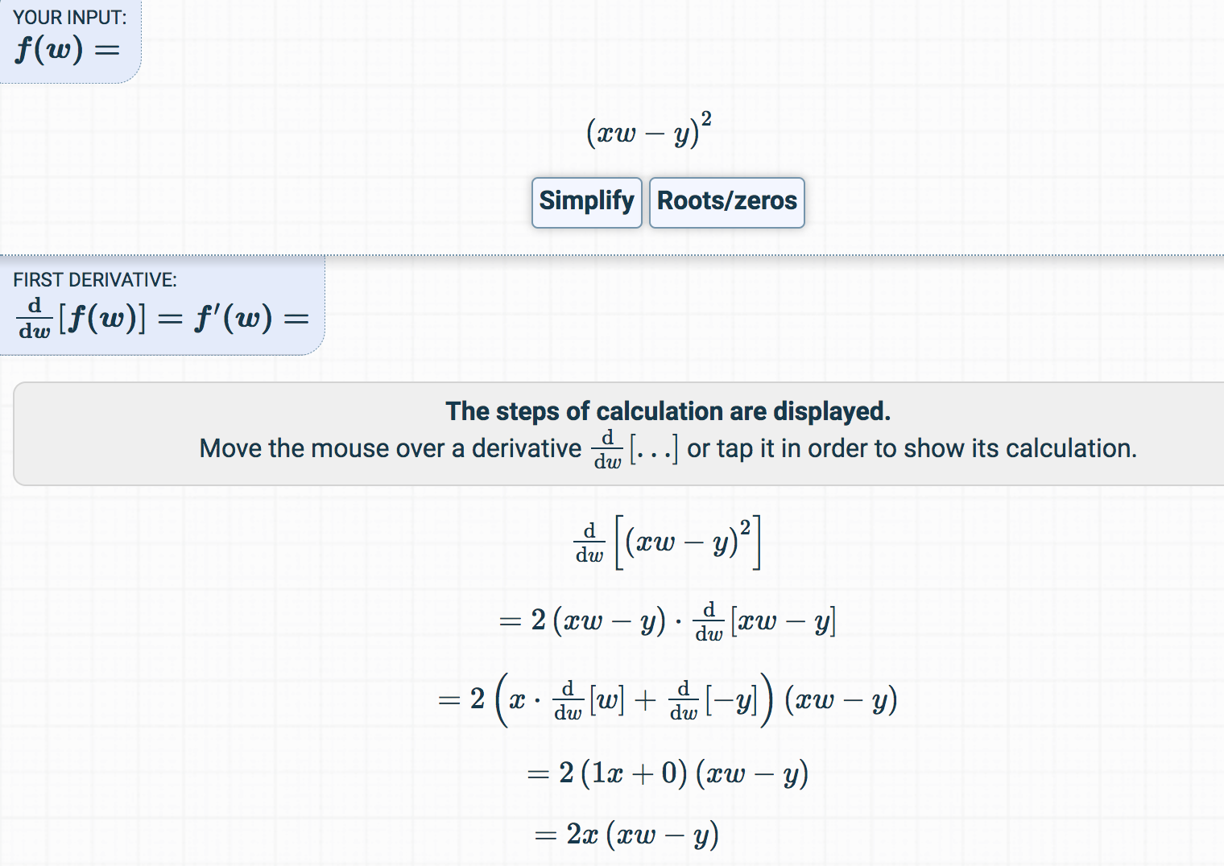
Derivative
https://www.derivative-calculator.net/
Notes:
loss = (\hat{y}-y)^2 = (x*w-y)^2
\frac{\partial{loss}}{\partial{w}}=?

Slide 70

Let’s implement!
loss
loss
Notes:
loss = (\hat{y}-y)^2 = (x*w-y)^2
\frac{\partial{loss}}{\partial{w}}=?

Slide 71
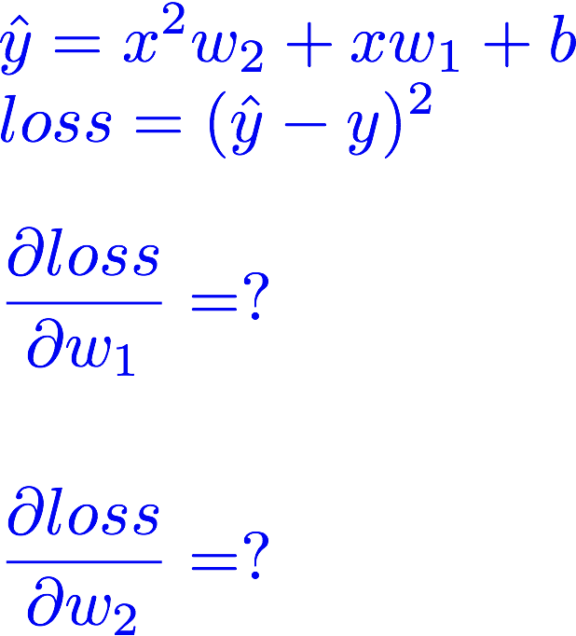
Exercise :compute gradient

Slide 72



